Slide 1
Writing Your Teaching Philosophy

Slide 2
“A teaching philosophy is a document that describes your general approach to teaching. Can you summarize for the search committee what your goals are when you teach? If you can articulate this and do so in a way that aligns with that institution’s own teaching philosophy or mission, then you will have done a good job at showing that you understand the role and responsibility that may take up a fair proportion of your life as a new faculty member.”
Notes:
Univ of Penn Career Services Center

Slide 3
What is a teaching statement?
A teaching statement, or statement of teaching philosophy, highlights academic job candidates’ teaching qualifications, explains their pedagogical approaches, and demonstrates how they will contribute to the teaching culture of prospective institutions.
Because hiring committees for academic jobs cannot observe the teaching of every applicant, they rely on other means of evaluating a candidate’s teaching.
An effective teaching statement involves both reflection and research.

Slide 4
A Teaching Statement can address any or all of the following:
Your conception of how learning occurs
A description of how your teaching facilitates student learning
A reflection of why you teach the way you do
The goals you have for yourself and for your students
How your teaching enacts your beliefs and goals
What, for you, constitutes evidence of student learning
The ways in which you create an inclusive learning environment
Your interests in new techniques, activities, and types of learning

Slide 5
General Guidelines
Make your Teaching Statement brief and well written. While Teaching Statements are probably longer at the tenure level (i.e., 3-5 pages or more), for hiring purposes they are typically 1-2 pages in length.
Use narrative, first-person approach. This allows the Teaching Statement to be both personal and reflective.

Slide 6
General Guidelines
Be sincere and unique. Avoid clichés, especially ones about how much passion you have for teaching.
Make it specific rather than abstract. Ground your ideas in 1-2 concrete examples, whether experienced or anticipated. This will help the reader to better visualize you in the classroom.

Slide 7
General Guidelines
Avoid jargon and technical terms, as they can be off-putting to some readers.
Try not to simply repeat what is in your CV. Teaching Statements are not exhaustive documents and should be used to complement other materials for the hiring or tenure processes.
Be discipline-specific. Do not ignore your research. Explain how you advance your field through teaching.

Slide 8
General Guidelines
Be humble. Mention students in an enthusiastic, not condescending way, and illustrate your willingness to learn from your students and colleagues.
Revise. Teaching is an evolving, reflective process, and Teaching Statements can be adapted and changed as necessary.
Should be tailored to the university you are applying to work at.

Slide 9
What constitutes a good statement?
They offer evidence of practice. Search committee chairs want to understand how candidates enact their teaching philosophies. In particular, they want to see specific and personal examples and experiences rather than vague references to educational jargon or formulaic statements.
They convey reflectiveness. Search committees want to know that a candidate is a thoughtful instructor. They are interested in candidates who can discuss their approach to instructional challenges and their plans for future pedagogical development.
They communicate that teaching is valued. Search chairs appreciate a tone or language that conveys a candidate's enthusiasm and commitment to teaching. They are wary of candidates who talk about teaching as a burden or a requirement that is less important than research.

Slide 10
What constitutes a good statement?
They are student- or learning-centered, attuned to differences in student abilities, learning styles, or levels. Search committee chairs want concrete evidence of a candidate's attentiveness to student learning (rather than just content) and awareness of and ability to deal with student differences in the classroom.
They are well written, clear, and readable. Search chairs draw conclusions about candidates from all elements of the application packet. Candidates can be undermined by carelessness in their teaching statements.

Slide 11
Do’s and Don’t…
Don’t give idyllic BUT empty concepts.
Don’t repeat your CV.
Do research on the teaching institution and disciplinary trends.
Do keep it short (one to two pages).
Do provide concrete examples and evidence of the usefulness of teaching concepts.
Do discuss the impact of methods, lessons learned, challenges, and innovations—how did students learn?
Do discuss connections between teaching, research, and service.
Do be discipline-specific.
Do cite your sources.
Show don’t tell…

Slide 12
Step 1: Who are you as a teacher?
Why do you teach?
What do you believe or value about teaching and student learning?
What should students expect of you as a teacher?
Students learn best by _______________.
The most effective methods for teaching are ________ because ________________.
How do your research and disciplinary context influence your teaching?
How do your identity/background and your students' identities/backgrounds affect teaching and learning in your classes?
How do you take into account differences in student learning styles in your teaching?
What is your approach to evaluating and assessing students?
If you had to choose a metaphor for teaching/learning, what would it be?

Slide 13
Examples…
Notes:
Add examples for each question above.

Slide 14
Step 2: Look at examples
As you look at sample teaching statements, think about what you do or do not like about each statement. The following questions can help you determine how you might construct your own statement.
What is the most memorable part of the teaching statement? Why?
How is the teaching statement organized (e.g., thematically, chronologically)?
How easily are you able to follow the structure of the statement?
What is the writing style of the teaching statement (e.g., formal, conversational)?
What impression of the writer does the writing style convey?
What image of the writer are you left with after reading the entire statement?
How well can you imagine yourself as a student in the writer’s class?

Slide 15
Step 3: Do your research
Different institutions have different expectations, depending on their mission and how they view the role of teaching within the broader responsibilities of being a faculty member.
Teaching philosophies of their faculty?
Align your teaching philosophy with the institution’s mission/values.
Align with the job posting.

Slide 16
Step 3: Do your research
How do the department’s offerings compare with common or standard course offerings in the field?
How do they compare with courses you have taken or taught?
How does your current research relate to the department’s course offerings?
Which courses would you be prepared to teach?
What future courses might you envision creating for the department?
Does the department offer any special courses, seminars, or initiatives relevant to your research or teaching experience?

Slide 17
Step 4: Begin with the end
Picture a student walking out of the final exam of your course:
In what way is that student different from the one who entered your classroom on the first day of the semester?
What has the student learned over the course of the past three months? You can think about that question in terms of both knowledge and skills.
Do you want students to have acquired some new body of knowledge? If so, why?
In what way does the acquisition of that new knowledge benefit the student or the world?
Will it help the student get a job?
Succeed in future courses?
Live a more meaningful life?

Slide 18
Step 5: Write (Remember good writing practices)
Engaging introduction
Body Paragraphs
One main idea/key topic per paragraph
Other sentences support the main idea
Transitions between paragraphs/ideas
Conclusion

Slide 19
Step 6: Evaluate
Evaluate your own work
Get feedback from others
*Grammarly
*Rubrics

Slide 20
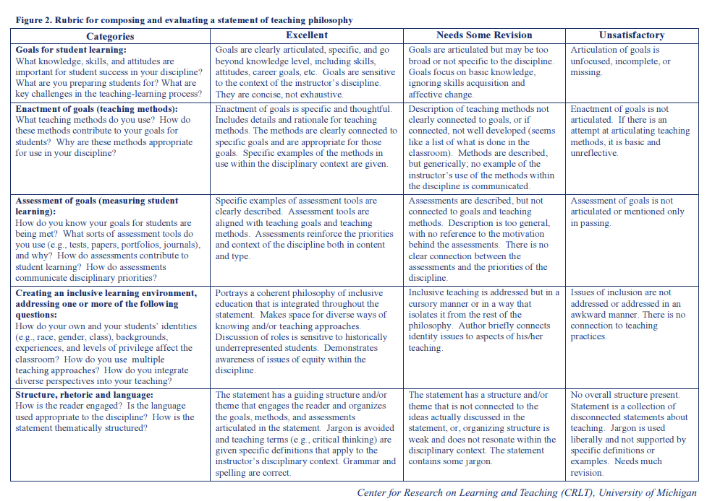

Slide 21
What if you haven’t taught?
Here are some strategies to help you draft a teaching statement, even if you aren’t an experienced teacher:
If you haven’t taught your own courses, draw upon experiences when you served as a teaching assistant for another instructor.
If you don’t have any experience teaching in a classroom, think of other transferable experiences like tutoring, coaching, or mentoring that illustrates what you would be like as a teacher.
If you have time, seek out teaching-related opportunities, such as giving guest lectures or mentoring junior colleagues.
If you really have no teaching experience, imagine and describe what you will be like as a teacher, propose courses that you could teach, and provide concrete techniques that you will employ in the classroom.
Think about good teaching you experienced as a student.

Slide 22
Resources
Teaching Goals Inventory - https://tgi.its.uiowa.edu/

